Slide 1

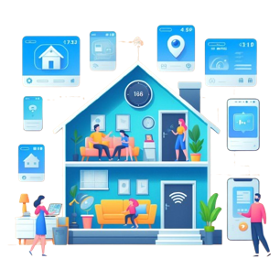
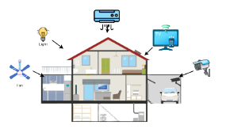
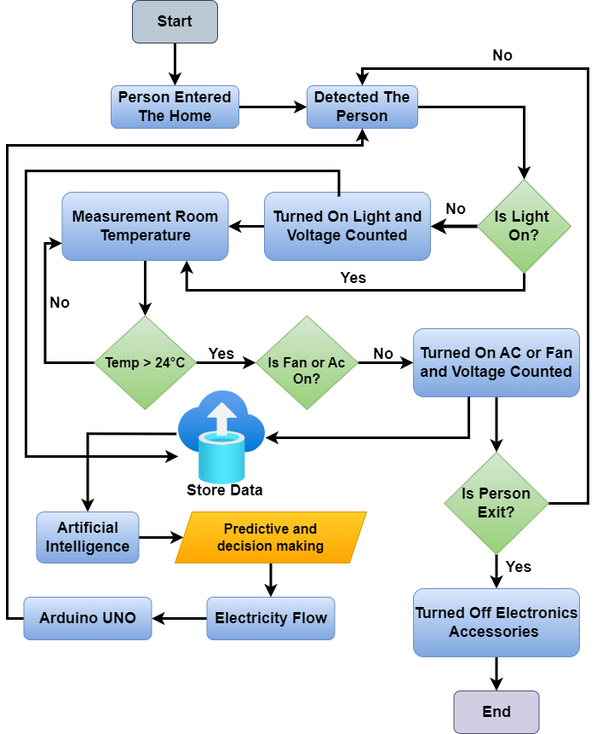
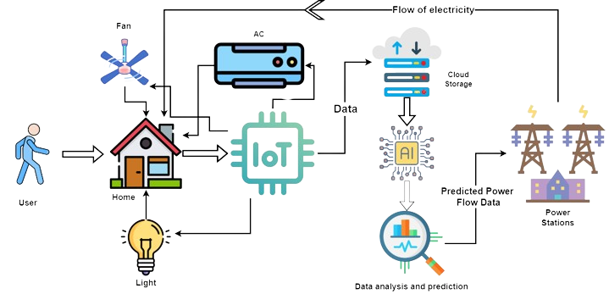
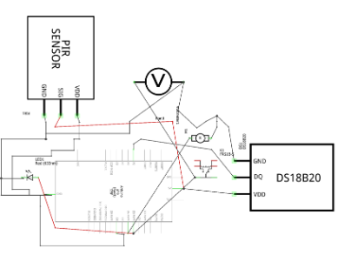
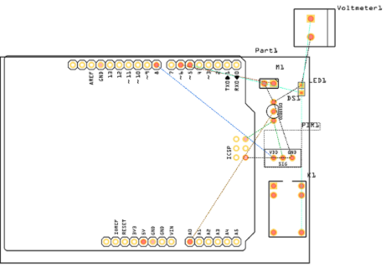



Smart Sage: IoT-Driven Home Automation Framework with Predictive Machine Learning
Rayhan Al Shorif and Khondaker Abdullah Al Mamun
Overview
Introduction
In the modern generation, the use of automation or AI has become an integral part of our lives. As a result, today it affects various aspects such as transportation and communication, communication, even starting from the rising of the sun every morning and household chores till sunset. Smart home apps are changing the standard of living of people and helping people to do any task very easily, considering this is our endeavor. Nowadays people are more and more attracted towards automation so this paper considers basically how to automate a home or office appliance using machine learning and Arduino Uno. Also, it measures the voltage of the electricity from them to
give an idea or framework of what the future electricity demand might be for them.
The home self-regulation concept is growing in popularity for reducing human effort including errors and thus increasing efficiency. We can manage remote home appliances help of Home self-regulation. Over and above that, the home self-regulation system can also integrate other ardors like alarms, emergency systems, security, etcetera.
Prediction With Machine Learning
Data Flow Diagram of the Proposed System
Methodology of This System
Future Works
Conclusion
Autism is one of the most concerning developmental disorder in toddlers. Though awareness is growing, autism screening and treatment process have not improved in developing countries. Autism Barta is the first step towards automation of autism screening in the context of developing countries like Bangladesh [2]. It is expected that, Autism Barta will bring revolutionary changes in the current condition of autism screening and treatment in developing countries like Bangladesh.
Schematic and PCB of Proposed system
References
Acknowledgements
[1] C. W. Allen, N. Silove, K. Williams, and P. Hutchins, “Validity of the Social Communication Questionnaire in Assessing Risk of Autism in Preschool Children with Developmental Problems,” J. Autism Dev. Disord., vol. 37, no. 7, pp. 1272–1278, 2007.
[2] “Advancing Autism Screening in Developing Countries | Science News | Autism Speaks.” [Online]. Available: https://www.autismspeaks.org/science/science-news/advancing-autism-screening-developing-countries. [Accessed: 11-May-2016].
Evdokia Anagnostou and Jessica Brian

Slide 2
Smart Sage: IoT-Driven Home Automation Framework with Predictive Machine Learning
Rayhan Al Shorif and Khondaker Abdullah Al Mamun
Overview
Introduction
In the modern generation, the use of automation or AI has become an integral part of our lives. As a result, today it affects various aspects such as transportation and communication, communication, even starting from the rising of the sun every morning and household chores till sunset. Smart home apps are changing the standard of living of people and helping people to do any task very easily, considering this is our endeavor. Nowadays people are more and more attracted towards automation so this paper considers basically how to automate a home or office appliance using machine learning and Arduino Uno. Also, it measures the voltage of the electricity from them to
give an idea or framework of what the future electricity demand might be for them.
The home self-regulation concept is growing in popularity for reducing human effort including errors and thus increasing efficiency. We can manage remote home appliances help of Home self-regulation. Over and above that, the home self-regulation system can also integrate other ardors like alarms, emergency systems, security, etcetera.
Prediction With Machine Learning
Data Flow Diagram of the Proposed System
Prototype Design Of The Proposed System
Future Works
Conclusion
Autism is one of the most concerning developmental disorder in toddlers. Though awareness is growing, autism screening and treatment process have not improved in developing countries. Autism Barta is the first step towards automation of autism screening in the context of developing countries like Bangladesh [2]. It is expected that, Autism Barta will bring revolutionary changes in the current condition of autism screening and treatment in developing countries like Bangladesh.
References
Acknowledgements
[1] C. W. Allen, N. Silove, K. Williams, and P. Hutchins, “Validity of the Social Communication Questionnaire in Assessing Risk of Autism in Preschool Children with Developmental Problems,” J. Autism Dev. Disord., vol. 37, no. 7, pp. 1272–1278, 2007.
[2] “Advancing Autism Screening in Developing Countries | Science News | Autism Speaks.” [Online]. Available: https://www.autismspeaks.org/science/science-news/advancing-autism-screening-developing-countries. [Accessed: 11-May-2016].
Evdokia Anagnostou and Jessica Brian

